Slide 1
CLOUD COMPUTING PLATEFORM JAVA GUVI PROJECT
A ROLE – BASE CLOUD RESOURCE DEPLOYMENT & MONITORING SYSTEM

Slide 2

CSE(DS) sem-3rd Java Programming:- R1UC304C Section- 33

Slide 3
Introduction to Cloud Computing Using Java
Cloud computing provides on-demand computing resources over the internet.
Java is widely used to develop cloud-based and distributed applications.
Java supports platform independence, scalability, and security in cloud systems.
Cloud services like SaaS, PaaS, and IaaS can be accessed using Java APIs.
Java is commonly used with cloud platforms such as AWS, Azure, and Google Cloud.

Slide 4
Cloud Computing Architecture with Java Applications
Cloud architecture consists of client layer, application layer, and cloud infrastructure layer.
Java applications run on cloud servers using JVM, ensuring platform independence.
Java-based services communicate through APIs and web services.
Cloud resources are dynamically allocated to Java applications for scalability.
Security and data management are handled using cloud and Java security mechanisms.

Slide 5
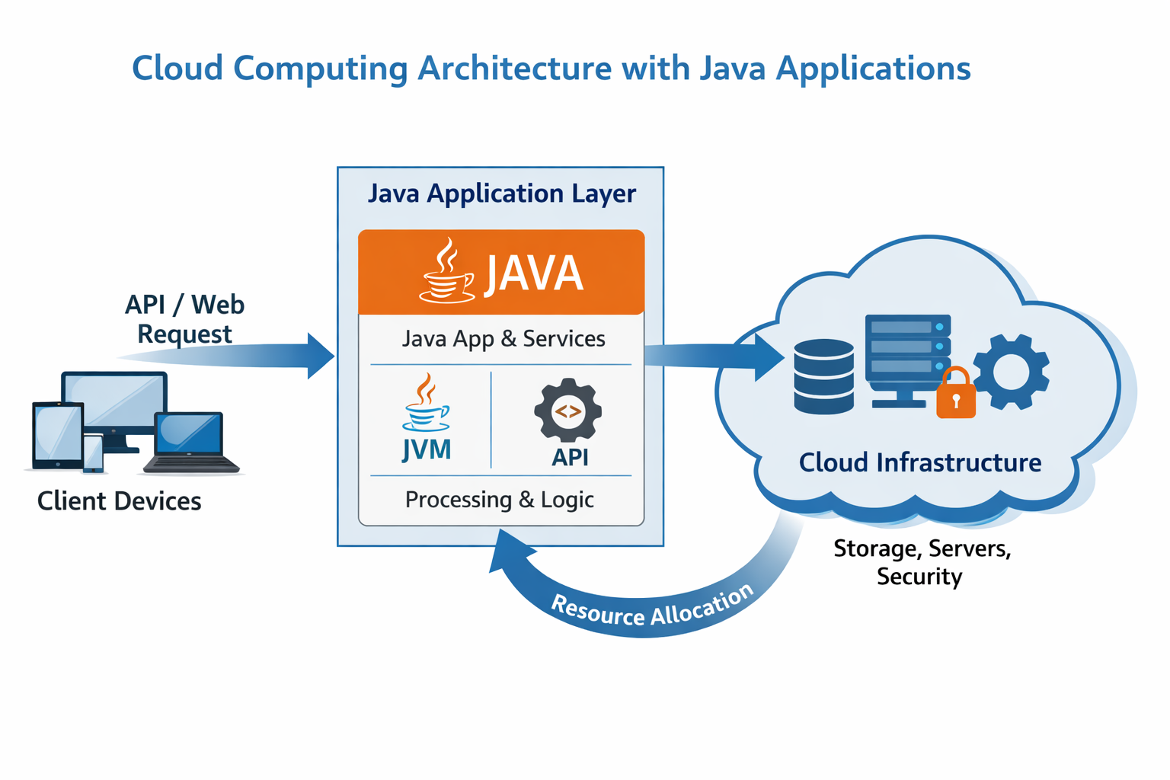
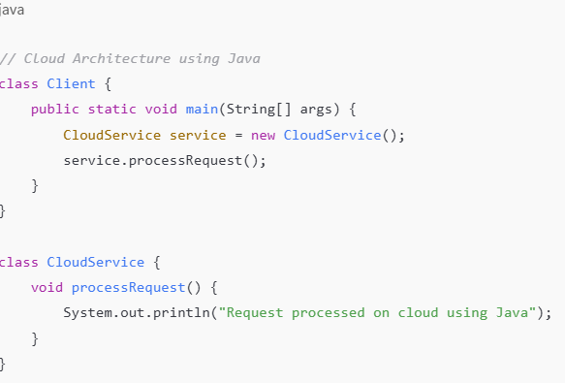
Architecture Flow

Slide 6
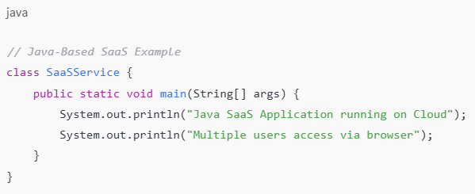
Java-Based SaaS (Software as a Service)
Java is widely used to develop SaaS applications due to its platform independence.
SaaS applications are hosted on the cloud and accessed through web browsers.
Java frameworks like Spring and Hibernate support scalable SaaS development.
Multiple users can access the same Java application using a single cloud instance.
Java-based SaaS reduces installation cost and simplifies maintenance.

Slide 7
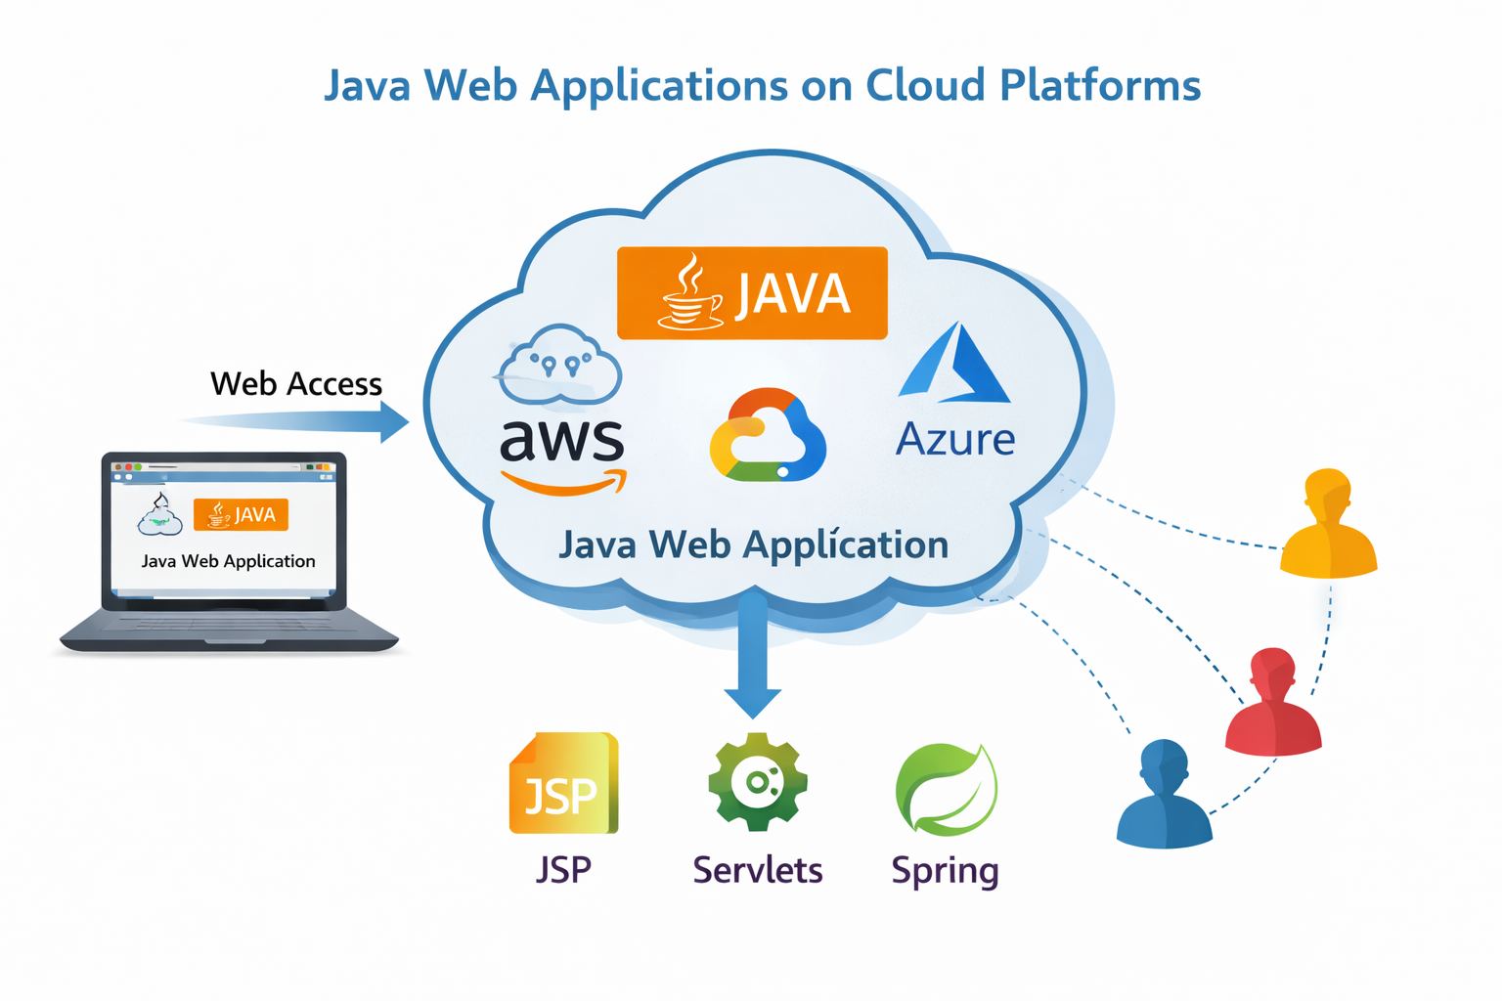
Java Web Applications on Cloud Platforms
Java web applications are deployed on cloud servers for high availability.
Cloud platforms provide scalability to handle multiple users efficiently.
Java technologies like JSP, Servlets, and Spring are commonly used.
Cloud hosting reduces infrastructure and maintenance costs.

Slide 8
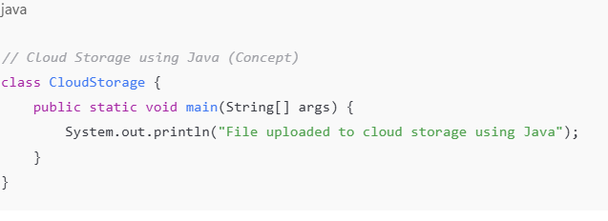
Cloud Storage Management Using Java
Cloud storage allows data to be stored and accessed over the internet.
Java is used to upload, download, and manage files in cloud storage.
Cloud storage provides scalability, reliability, and data backup.
Java APIs/SDKs help connect applications to cloud storage services.
It reduces the need for local storage and maintenance cost.

Slide 9
Virtualization and Cloud Computing with Java
Virtualization allows multiple virtual machines to run on a single physical server.
Cloud computing uses virtualization to efficiently share hardware resources.
Java applications run inside virtual machines using the JVM.
Virtualization improves scalability, resource utilization, and cost efficiency.
Java supports cloud-based virtual environments through platform independence.

Slide 10
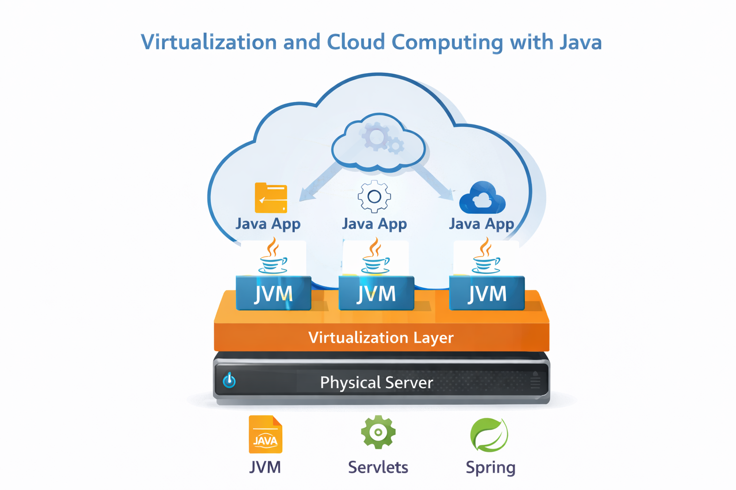

Slide 11
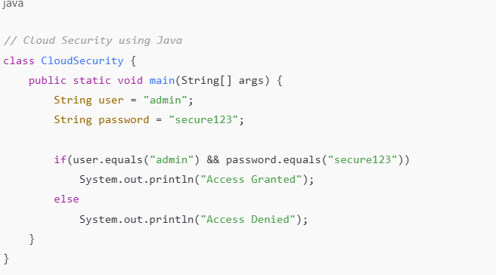
Cloud Security Implementation Using Java
Cloud security protects data, applications, and services from unauthorized access.
Java provides built-in security features like authentication and encryption.
Secure access control ensures only authorized users can use cloud resources.
Java helps maintain data confidentiality and integrity in cloud systems.

Slide 12
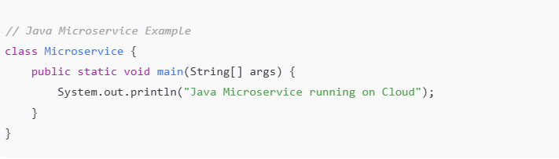
Microservices and Cloud Computing Using Java
Microservices architecture divides an application into small, independent services.
Each microservice is developed, deployed, and scaled separately on the cloud.
Java (Spring Boot) is commonly used to build microservices.
Microservices improve scalability, flexibility, and fault tolerance.

Slide 13
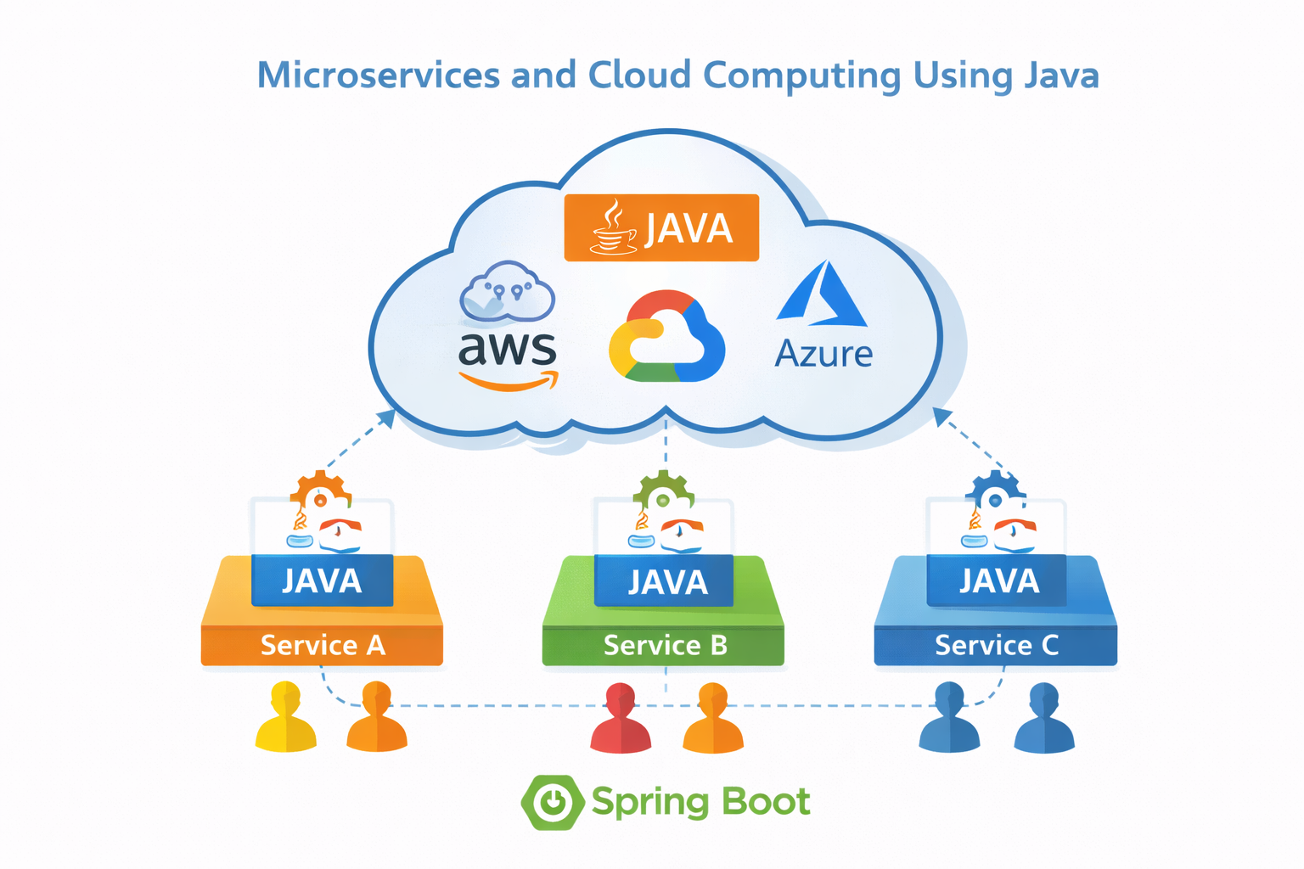
THANK YOU
Submitted by :-
Prashant Kumar(24scse1420132)
Piyush Raj(24scse1420122)
Arth Pratap Singh (24scse1420143)

